Slide 1









Development of the targeted Educational program for Bachelors in Solar Energy in Uzbekistan
101128871 — DEBSEUz — ERASMUS-EDU-2023-CBHE
Presentation of Universidad Politecnica de Madrid UPM, Spain
Slobodan Bojanic, UPM
DEBSEUz Kick-Off Meeting, Tashkent 22-24 Jan 2024

Slide 2




Universidad Politécnica de Madrid UPM
Development of the targeted Educational program for Bachelors in Solar Energy in Uzbekistan
101128871 — DEBSEUz — ERASMUS-EDU-2023-CBHE
Oldest and largest Spanish technical university.
Almost 3,000 faculty members, 414 researchers and 1,900 administrative staff.
Around 36,000 undergraduate and master’s students. and 1,900 doctoral students.
18 UPM schools cover most engineering disciplines.
160 bachelor’s and master’s degrees,
  47 internationally accredited.

Slide 3
UPM
Development of the targeted Educational program for Bachelors in Solar Energy in Uzbekistan
101128871 — DEBSEUz — ERASMUS-EDU-2023-CBHE
Sends 1,800 and receives 1,300 students per year.
Erasmus+, Magalhães, China Scholarship Council, Heritage, etc. programs.
Office exclusively dedicated for support of incoming students and staff exchange.
Assistance for accommodation and immigration procedures, especially for non-EU citizens.
Coordinator or partner in ~50 Erasmus+ KA2 projects.

Slide 4
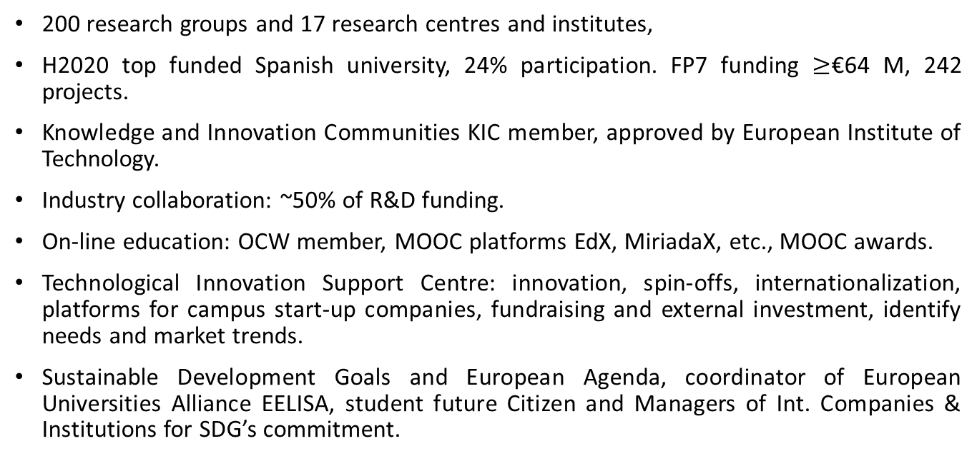
UPM
Development of the targeted Educational program for Bachelors in Solar Energy in Uzbekistan
101128871 — DEBSEUz — ERASMUS-EDU-2023-CBHE
200 research groups and 17 research centres and institutes,
H2020 top funded Spanish university, 24% participation. FP7 funding $≥$€64 M, 242 projects.
Knowledge and Innovation Communities KIC member, approved by European Institute of Technology.
Industry collaboration: ~50% of R&D funding.
On-line education: OCW member, MOOC platforms EdX, MiriadaX, etc., MOOC awards.
Technological Innovation Support Centre: innovation, spin-offs, internationalization, platforms for campus start-up companies, fundraising and external investment, identify needs and market trends.
Sustainable Development Goals and European Agenda, coordinator of European Universities Alliance EELISA, student future Citizen and Managers of Int. Companies & Institutions for SDG’s commitment.

Slide 5
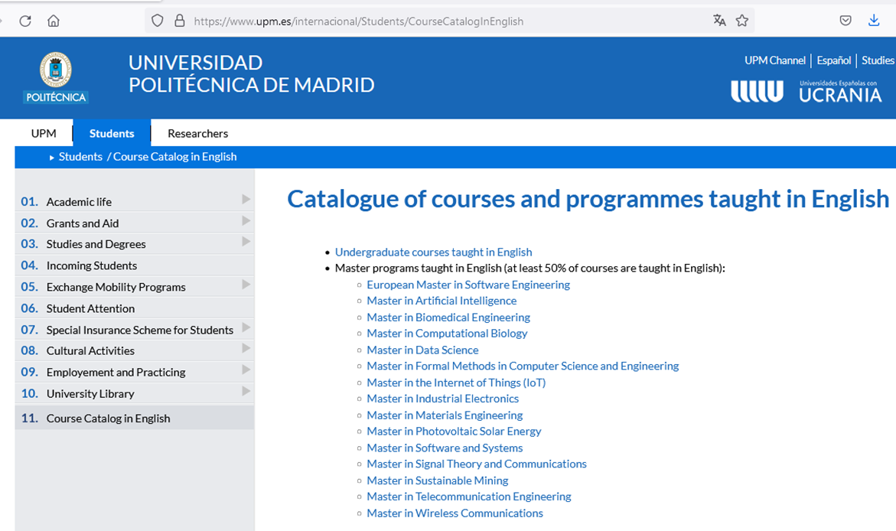
Development of the targeted Educational program for Bachelors in Solar Energy in Uzbekistan
101128871 — DEBSEUz — ERASMUS-EDU-2023-CBHE

Slide 6
Work package WP3 – Bachelor Degrees organization
Work Package Number WP3 Lead Beneficiary 4. UPM
Work Package Name Bachelor Degrees organization
Start Month 12 End Month 30
Development of the targeted Educational program for Bachelors in Solar Energy in Uzbekistan
101128871 — DEBSEUz — ERASMUS-EDU-2023-CBHE

Slide 7
Thank you for attention!
Development of the targeted Educational program for Bachelors in Solar Energy in Uzbekistan
101128871 — DEBSEUz — ERASMUS-EDU-2023-CBHE

